Slide 1
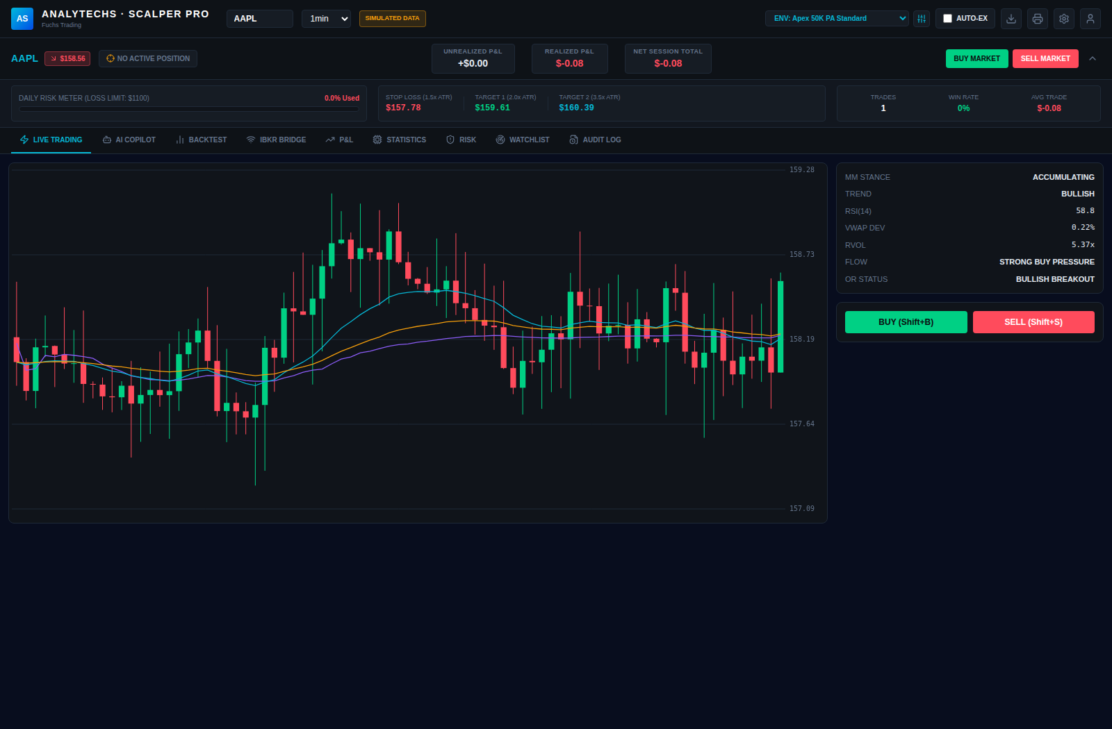
ANALYTECHS
INSTITUTIONAL
SCALPER PRO
A real-time equity scalping terminal built like prop-firm infrastructure — live signals, enforced risk, and honest data, all in one desk.
LIVE SIGNAL ENGINE · REAL BACKTESTER · IBKR / TWELVE DATA BRIDGE · GEMINI AI COPILOT

Slide 2




THE PROBLEM
Retail Scalping Tools Weren't Built To Be Trusted
Most scalping software asks you to take its word for it. Under real market pressure, that's not good enough.
Black-Box Signals
No Enforced Discipline
You can't verify the math behind a buy signal, so you can't trust it the moment it matters.
Daily loss limits and drawdown rules live in your head, not the software — one bad trade blows the account.
Backtests That Lie
Fake “Real-Time” Data
Marketing backtests are curve-fit fantasies that share no code path with the live engine.
Feeds silently fall back to stale or simulated prices with nothing telling you which you're looking at.
ANALYTECHS
02 / 15

Slide 3




THE PLATFORM
One Terminal. One Risk Engine. Total Transparency.
Analytechs Institutional Scalper Pro streams live signals, enforces risk on every order path, and replays real backtests through the exact math the live feed uses — nothing you see can silently diverge.
Live Signal Engine
Risk-Gated Execution
Real Bar-by-Bar Backtesting
Honest Data, Always Labeled
20+ technical, “physics,” and statistical reads computed once per tick, server-side.
Buttons, hotkeys, and Auto-Execute all pass through one server-side risk check.
The exact same signal function the live feed uses, replayed against real history.
REAL / SIMULATED / DISCONNECTED badges on every quote, candle, and fill.
ANALYTECHS
03 / 15

Slide 4

LIVE TRADING
Every Signal, Computed Once, Streamed Everywhere
EMA 20/50/200, Wilder's RSI, MACD, Bollinger Bands, ATR, session VWAP + bands, Stochastic/StochRSI, OBV, Supertrend.
A regression-slope “physics” read and a skew/kurtosis “statistics” read alongside the standard indicator set.
Opening-range breakout status, gap %, RVOL, flow pressure, and an MM-stance heuristic — at a glance.
Computed server-side once per tick and streamed over an authenticated WebSocket, so every open tab sees identical numbers.
ANALYTECHS
04 / 15

Slide 5





ORDER EXECUTION
Buttons. Hotkeys. Auto-Execute. One Path.
However you pull the trigger, every order runs through the exact same authenticated endpoint — and the exact same server-side risk check — before a fill is ever recorded.
Click
Hotkey
Auto-Execute
BUY MARKET / SELL MARKET buttons on the live trading desk.
Shift+B / Shift+S / Shift+X for split-second scalping without leaving the keyboard.
Arm AUTO-EX to fire automatically the instant a qualifying signal appears.
No client-side bypass: the daily loss limit, trailing drawdown, cooldown, and trade-count cap apply identically to every path — there is no faster “quiet” route around the risk engine.
ANALYTECHS
05 / 15

Slide 6
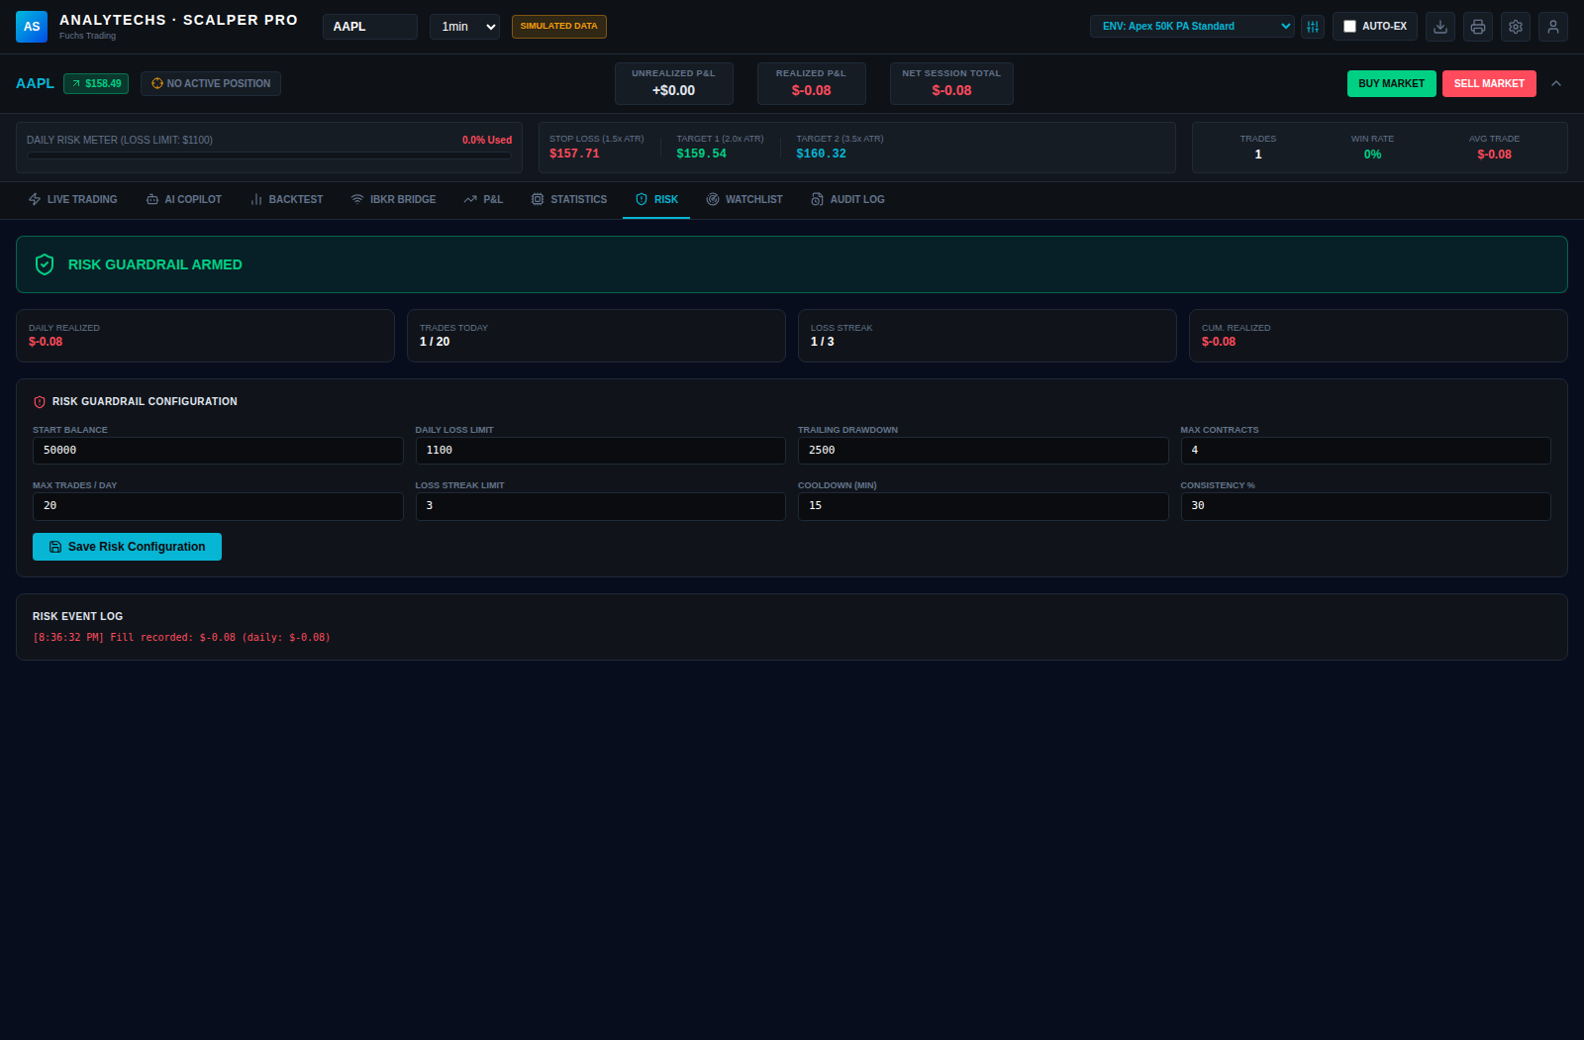
RISK MANAGEMENT
Prop-Firm-Grade Guardrails, Enforced Server-Side
Daily Loss Limit — locks new order placement for the rest of the day once breached.
Trailing Drawdown — locks trading if cumulative P&L falls below its peak by your configured amount.
Max Contracts and Max Trades / Day — hard caps enforced on every order, every session.
Loss-Streak Limit & Cooldown — blocks new entries for a configured period after N consecutive losers.
ANALYTECHS
06 / 15

Slide 7
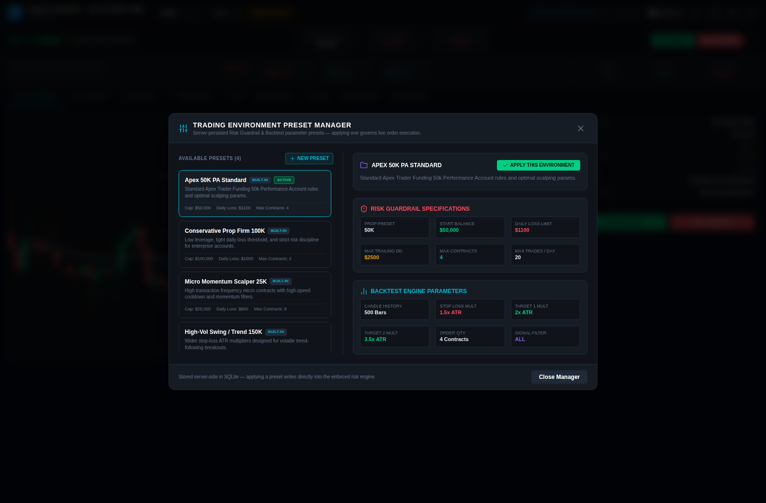
CONFIGURATION
Built for Prop Accounts — Out of the Box
Four built-in environment presets model common Apex-style prop-firm rule sets, plus unlimited custom presets of your own.
Apex 50K PA Standard — $50,000 cap, $1,100 daily loss limit, 4 max contracts.
Conservative Prop Firm 100K — low leverage, tight daily loss threshold, strict discipline.
Micro Momentum Scalper 25K — high-speed cooldown and momentum filters for small accounts.
Applying a preset writes directly into the enforced risk engine — server-persisted in SQLite, live instantly.
ANALYTECHS
07 / 15

Slide 8
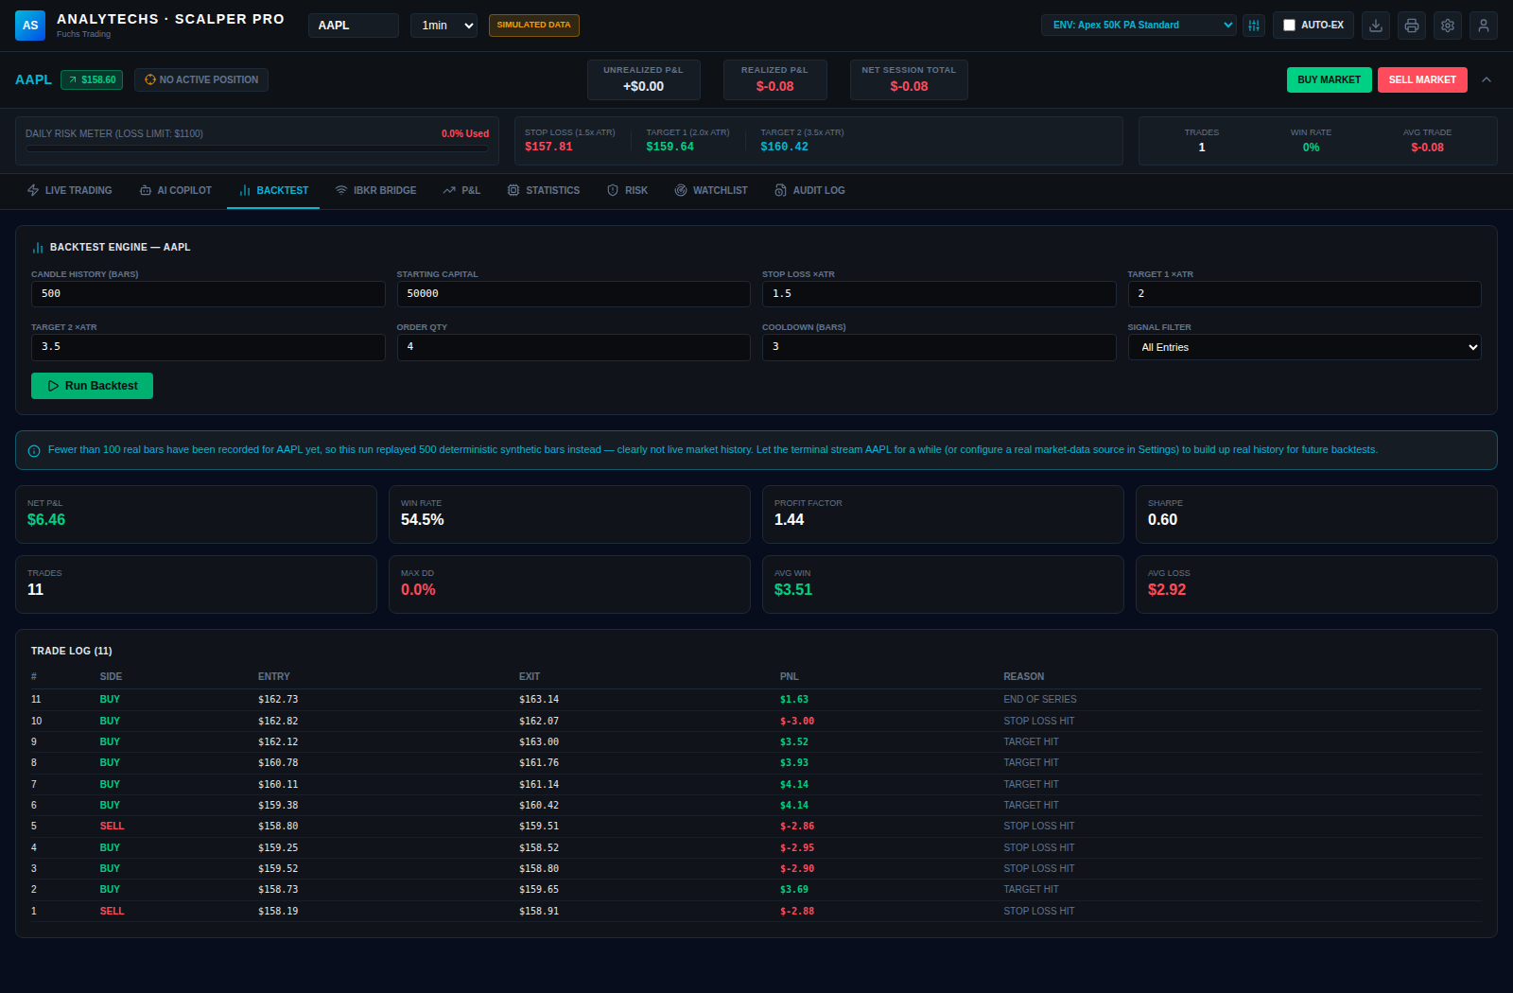
VALIDATION
A Genuine Trade Log — Never a Random Number Generator
Replays candle history bar by bar through the exact computeSignals() function the live feed uses.
Applies your stop-loss, target 1/2, signal filter, and cooldown parameters to open and close simulated trades.
Win rate, profit factor, Sharpe ratio, and max drawdown are all derived from that resulting real trade log.
Every run states plainly whether it replayed real persisted history or a clearly-labeled synthetic series.
ANALYTECHS
08 / 15

Slide 9



AI COPILOT
A Second Set of Eyes, Powered by Gemini
One click sends your current symbol, price, interval, live signal readout, and risk state to Google's Gemini model for a structured, context-aware read.
Structured Market Read
Suggested Scalp Levels
Market regime and directional bias with a confidence score, plus the key drivers behind the call.
Long/short entry ideas with a stop-loss and two targets — informational, never auto-placed.
Free-Form Trading Chat
Analysis Only, Always
Ask anything — the same live context is included with every message you send.
The Copilot never places, modifies, or cancels an order on its own — you act through the normal controls.
ANALYTECHS
09 / 15

Slide 10
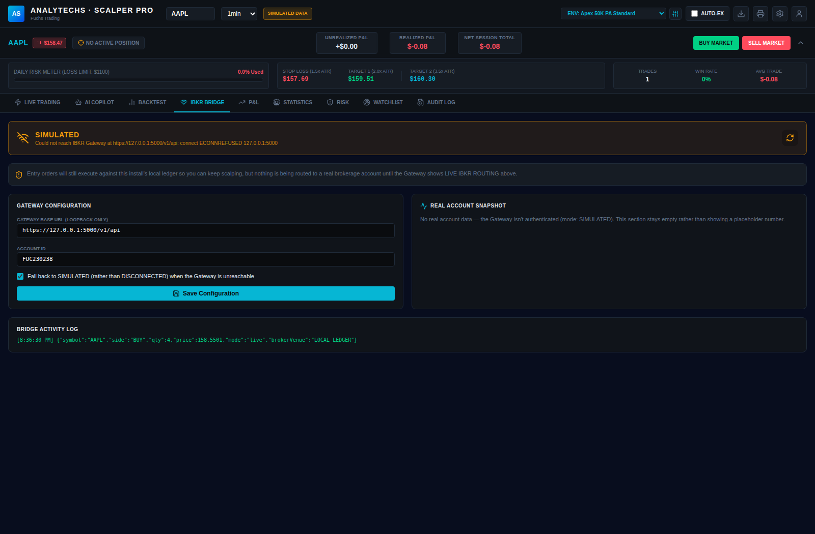
MARKET & BROKER BRIDGE
REAL. SIMULATED. Never Silently Substituted.
Connects to a locally-run IBKR Client Portal Gateway, with optional Twelve Data quotes for real prices without it.
Every quote, candle, and broker fact carries an explicit REAL / SIMULATED / DISCONNECTED provenance badge.
IBKR connections are loopback-only — the backend refuses any Gateway URL that isn't localhost, even via direct database edit.
Falls back to a clearly-labeled simulator rather than failing closed — or faking a feed you'd never catch.
ANALYTECHS
10 / 15

Slide 11
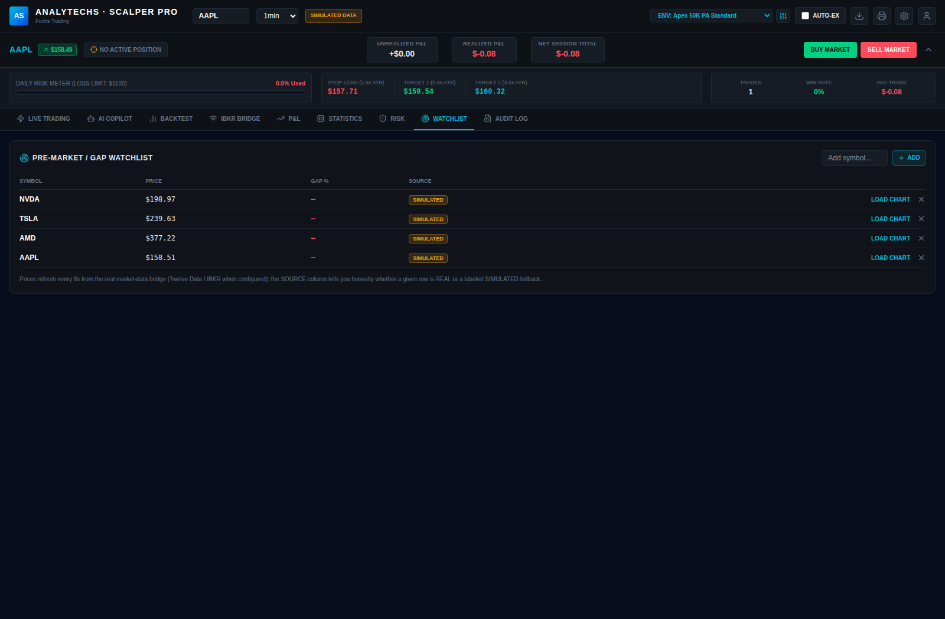
MARKET PREP
Know Your Gappers Before the Bell
A dedicated pre-market / gap watchlist for every symbol you manage.
Prices refresh every 8 seconds from the real market-data bridge — IBKR or Twelve Data when configured.
One click on “Load Chart” jumps straight into that symbol's live signal feed.
The same honest REAL / SIMULATED source labeling used everywhere else in the app.
ANALYTECHS
11 / 15

Slide 12
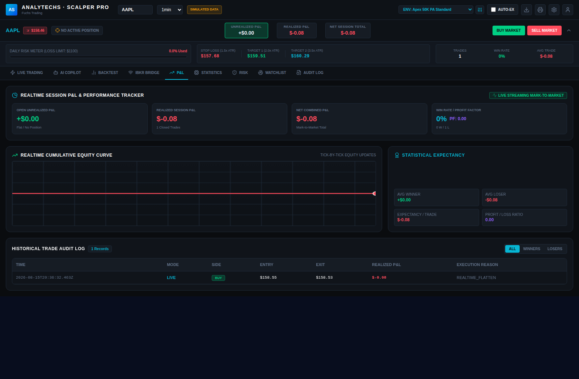
PERFORMANCE
Realtime, Tick-by-Tick Mark-to-Market
A live cumulative equity curve that updates with every tick, not just at trade close.
Win rate, profit factor, average winner/loser, and per-trade statistical expectancy at a glance.
A full historical trade audit log, filterable by all trades, winners, or losers.
One-click CSV export of the session blotter, and a printable trading audit statement.
ANALYTECHS
12 / 15

Slide 13

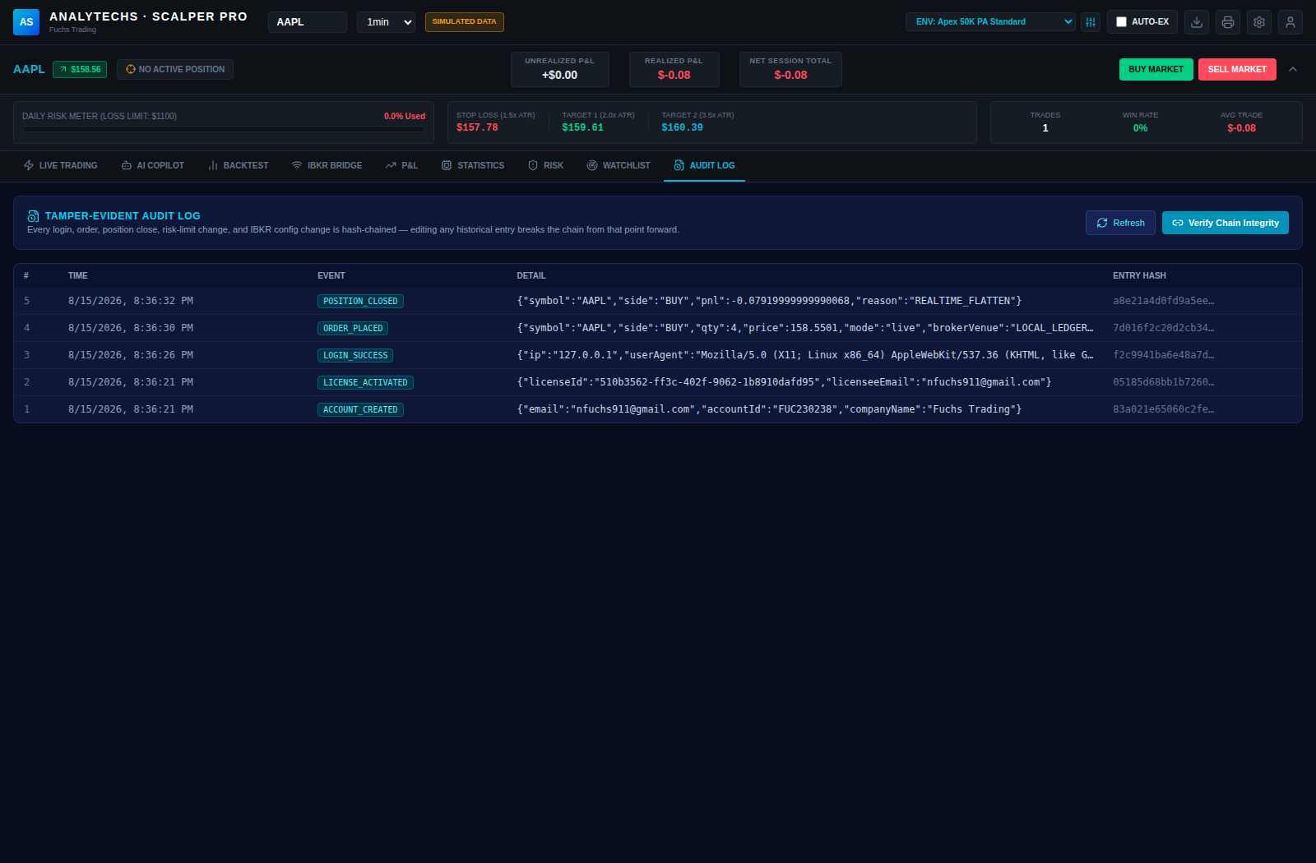
SECURITY
Tamper-Evident by Design
Every security-relevant event is written to a SHA-256 hash chain — editing history breaks the chain from that point forward.
Bcrypt-hashed passwords, httpOnly / sameSite session cookies, and optional RFC 6238 two-factor authentication.
“One user per install” enforced at the SQLite schema level — not just application code, so it can't be bypassed by calling the API directly.
Verify Chain Integrity re-walks the entire log from genesis on demand and reports the first mismatch, if any.
ANALYTECHS
13 / 15

Slide 14



GO TO MARKET
Two Ways to Run It — One Codebase
Personal Mode for your own desk. Distributable Mode to sell it, license it, and hand it to customers you don't fully control.
Personal Mode
Distributable Mode
Skips the setup screen, the login screen, and the license gate entirely.
Ed25519-signed offline license keys — verified with no phone-home required, ever.
A local account is auto-provisioned the first time the server starts.
One-time Setup screen, then password (+ optional TOTP) sign-in on every launch.
Packages as its own dedicated Electron desktop app — no .env needed.
Mint a perpetual or time-boxed key for any customer in a single command.
Only for a machine you fully trust: it removes all login security.
Ships as a signed Windows / macOS / Linux desktop app via electron-builder.
ANALYTECHS
14 / 15

Slide 15

GET STARTED
Put an Institutional-Grade
Scalping Desk on Your Desktop
01
02
03
Install
Configure
Go Live
npm install — Node.js 20+, one command to pull every dependency.
Pick a built-in risk preset or define your own — applies instantly, server-side.
Trade simulated, or connect IBKR / Twelve Data for real quotes and fills.
Contact: Norman Fuchs — nfuchs911@gmail.com
Not a licensed broker-dealer. Not investment advice. Trading involves risk of loss.

