Slide 1
PRODUCT OVERVIEW
Bond Trading App
Institutional-Grade Fixed Income Trading Terminal
By PolyApps AI
LIVE EXECUTION · REAL-TIME RISK · AI MARKET INTELLIGENCE
Notes:
Welcome to the Bond Trading App, from PolyApps AI. This is an institutional-grade fixed income trading terminal that brings live execution, portfolio risk, market intelligence, and compliance together in a single professional workspace. Let's take a look at what it can do.

Slide 2

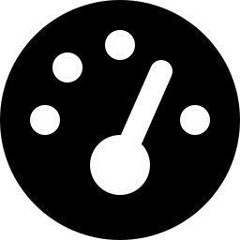

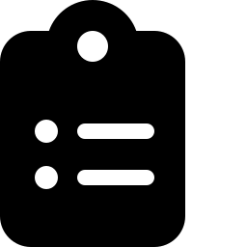
THE PROBLEM
Fixed income traders juggle too many disconnected tools
Fragmented workflow
No live risk view
Pricing in one tool, execution in another, risk in a spreadsheet
Portfolio duration, VaR, and concentration calculated after the fact
Slow, manual analysis
Compliance as an afterthought
Yield curve, credit, and inflation signals tracked by hand
Thin or missing audit trails on live trading activity
BOND TRADING APP
2 / 15
Notes:
Bond desks and serious individual traders face the same problem: pricing lives in one tool, execution in another, and risk gets calculated after the fact in a spreadsheet. Yield curve, credit, and inflation signals are tracked by hand, and compliance is often an afterthought instead of built in from the start.

Slide 3


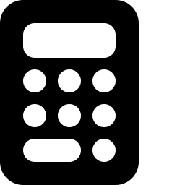

THE SOLUTION
One terminal. Execution, risk, analytics, AI, and compliance.
Live execution
Real-time risk
Real Interactive Brokers connectivity, not a simulation
VaR, scenario ladders, and concentration on every position
Deep analytics
AI market intelligence
Professional bond math built in, no separate terminal needed
Grounded briefings and chat, with hard safety guardrails
BOND TRADING APP
3 / 15
Notes:
The Bond Trading App replaces that patchwork with one terminal. Live execution through a real Interactive Brokers connection, real-time portfolio risk, deep professional bond analytics, and grounded AI market intelligence — all in one secure workspace, with compliance built in rather than bolted on.

Slide 4

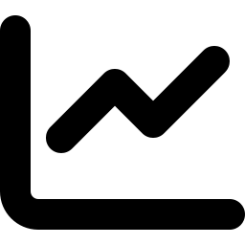
DASHBOARD
A live snapshot of markets and your portfolio
Composite Market Stress Score
Top anomalies
One number that blends curve, credit, and volatility signals
Automatic detection of statistically unusual moves
Yield curve snapshot
Quick actions
The full curve, at a glance, on load
Jump straight into orders, watchlist, or risk
BOND TRADING APP
4 / 15
Notes:
The Dashboard opens with a live snapshot of markets and your portfolio: a composite market stress score that blends curve, credit, and volatility signals into one number, the top statistically-detected anomalies, and a yield curve snapshot — all before you click a single tab.

Slide 5


WATCHLIST & PORTFOLIO
Track what matters, monitor what you own
Custom watchlist
Add any Treasury, corporate, or municipal instrument
Live holdings view
Positions, marks, and P&L in one table
Fast lookups
No switching to a separate pricing terminal
BOND TRADING APP
5 / 15
Notes:
The Watchlist lets you add any Treasury, corporate, or municipal instrument you're tracking, while the Portfolio tab gives you a live view of your actual holdings — positions, marks, and profit and loss — without ever switching to a separate pricing terminal.

Slide 6

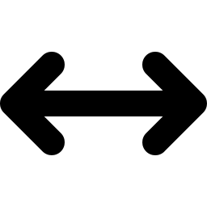

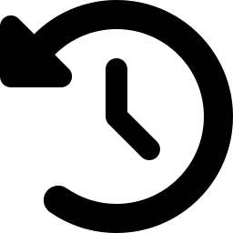
ORDERS & EXECUTION
Real orders, routed to your real brokerage account
Live IBKR connection
Relative-value & multi-leg tickets
This submits real, live orders — not a simulator
Built for spread and curve trades
Staged order review
Full order history
Confirm before anything goes live
Every order, every status, always visible
BOND TRADING APP
6 / 15
Notes:
The Orders tab is where this becomes a real trading tool, not a demo. It connects directly to Interactive Brokers and submits real, live orders to your actual brokerage account. It supports relative-value and multi-leg tickets for spread and curve trades, stages every order for review before it goes live, and keeps a complete order history.

Slide 7

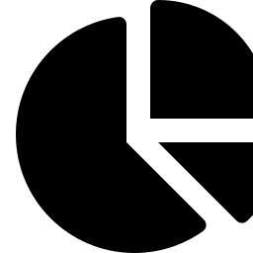

RISK & REPORTING
Know your risk before the market tells you
1-Day 95% Parametric VaR
Portfolio scenario ladder
Rate risk, quantified
Model parallel yield shocks instantly
Concentration & aggregate risk
Configurable risk limits
See where exposure is stacking up
Guardrails enforced before trades execute
BOND TRADING APP
7 / 15
Notes:
The Risk and Reporting tab quantifies your exposure with one-day, ninety-five percent parametric Value at Risk, a portfolio scenario ladder for instant parallel yield shocks, and concentration analysis so you can see where exposure is stacking up. Configurable risk limits are enforced before trades execute, not just reported after.

Slide 8


COMPLIANCE
Every action logged, every log reviewable
Full audit trail
Logins, orders, risk rejections, AI usage — all captured
Tamper-resistant logging
Structured, timestamped, queryable
Built for review
Ready for internal or external audit
BOND TRADING APP
8 / 15
Notes:
Compliance isn't bolted on afterward — the Audit Log captures every login, every order, every risk rejection, and every AI query, timestamped and structured for internal or external review. It's built to give a real answer when someone asks what happened and why.

Slide 9
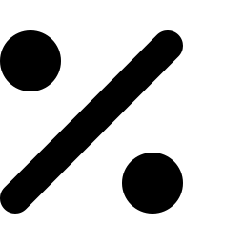
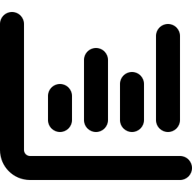
MARKET INDICATORS
See the signals before they're headlines
U.S. Treasury yield curve
Inversion warning signals
Full curve, updated continuously
2s10s, 3m10y, 2s30s and more
Recession probability model
Credit spreads & volatility
A data-driven read on macro risk
Investment grade, high yield, and MOVE index
BOND TRADING APP
9 / 15
Notes:
The Indicators tab tracks the U.S. Treasury yield curve continuously, watches classic inversion warning signals like 2s10s, 3-month 10-year, and 2s30s, and runs a recession probability model. Credit spreads and the MOVE volatility index round out a real macro risk picture.

Slide 10
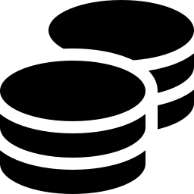
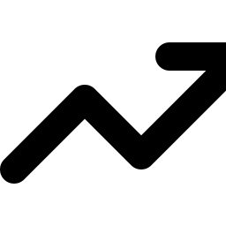
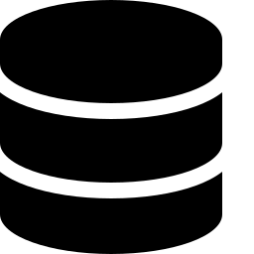
INFLATION & REAL RATES
Breakeven inflation and real yields, tracked live
5-year & 10-year breakevens
What the market is pricing for inflation
Real 10-year yield
The rate that actually matters for valuation
Sourced from FRED & market data
Transparent, citable data sources
BOND TRADING APP
10 / 15
Notes:
Alongside credit and volatility, the app tracks 5-year and 10-year breakeven inflation and the real 10-year yield — the rate that actually matters for valuing everything else — sourced transparently from FRED and live market data feeds.

Slide 11

BOND ANALYTICS
Professional bond math, built in
YAS / DUR calculator
Z-spread
Price, yield, and risk in one place
Spread to the full Treasury curve
Scenario / what-if ladder
Muni yield, key-rate duration & roll-down
Parallel yield shocks, instantly
The functions a real fixed income desk actually uses
BOND TRADING APP
11 / 15
Notes:
The Analytics tab puts real bond math at your fingertips: a YAS and duration calculator, Z-spread to the full Treasury curve, a parallel yield-shock scenario ladder, municipal tax-equivalent yield, key-rate durations, and roll-down return — the functions a real fixed income desk actually uses every day.

Slide 12



AI MARKET ASSISTANT
Grounded AI analysis, with hard guardrails
One-click market briefing
Grounded follow-up chat
A narrative generated from your live data snapshot
Ask questions about the curve, credit, or your watchlist
Never trades for you
Descriptive, not advice
No order access — by design, not just by prompt
Clearly framed as analysis, never a recommendation
BOND TRADING APP
12 / 15
Notes:
The AI Assistant generates a one-click market briefing grounded entirely in your live data snapshot, plus a follow-up chat for questions about the curve, credit, or your watchlist. It has zero access to orders, accounts, or trade execution — that's enforced in the code, not just the prompt — and it's built to describe markets, never to recommend or place a trade.

Slide 13


SECURITY
Built like it protects real money — because it does
Single-account lockdown
Brute-force lockout
One deployment, one account, no open signup
Automatic lockout after repeated failed logins
Session-based auth
Full audit trail
Encrypted, server-enforced, never client-side trust
Every login attempt, success or failure, recorded
BOND TRADING APP
13 / 15
Notes:
Because this connects to a real brokerage account, security isn't optional. Registration locks down to a single account per deployment, repeated failed logins trigger an automatic lockout, and every session is enforced server-side — never trusted to the browser. Every login attempt, successful or not, is recorded in the audit trail.

Slide 14
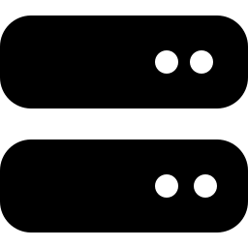
DEPLOYMENT
Runs where you want it to
Bring your own IBKR gateway
Connect the brokerage account you already use
Configurable data sources
Market and indicator data, sourced transparently
Private, trusted-operator mode available
For a fully self-hosted, single-operator setup
BOND TRADING APP
14 / 15
Notes:
The Bond Trading App connects to the Interactive Brokers gateway you already run, with configurable, transparent market data sources. A private, trusted-operator mode is also available for a fully self-hosted, single-user setup — you decide exactly where and how it runs.

Slide 15

GET STARTED
Trade fixed income like a desk, not a spreadsheet
www.polyapps-ai.com
Visit the site above for more information and to purchase
By PolyApps AI
Notes:
The Bond Trading App is built for traders who want a real terminal, not a patchwork of tools. To learn more and to purchase, visit www dot polyapps dash a i dot com. That's www.polyapps-ai.com. Thanks for watching.

