Slide 1
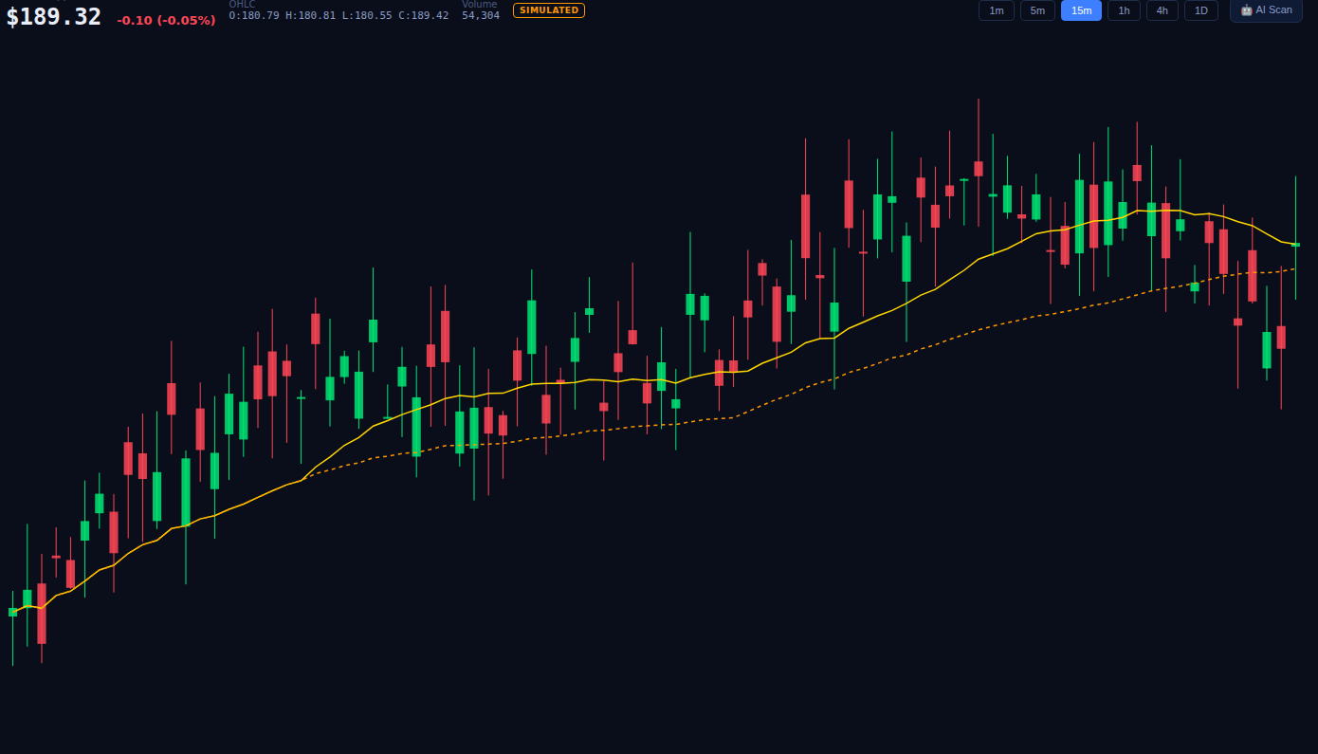
COMMERCIAL ALGORITHMIC TRADING PLATFORM
ALPHATRADER
PRO
COMMERCIAL
Real-time signals, an autonomous trading engine, and a live Interactive Brokers connection — hardened with multi-tenant infrastructure and bank-grade security.
Multi-Tenant SaaS
Real IBKR Execution
AI Copilot
2FA + Encrypted Secrets
For the professional trader — and the firm behind them.
ALPHATRADER PRO · COMMERCIAL EDITION
01 / 15

Slide 2
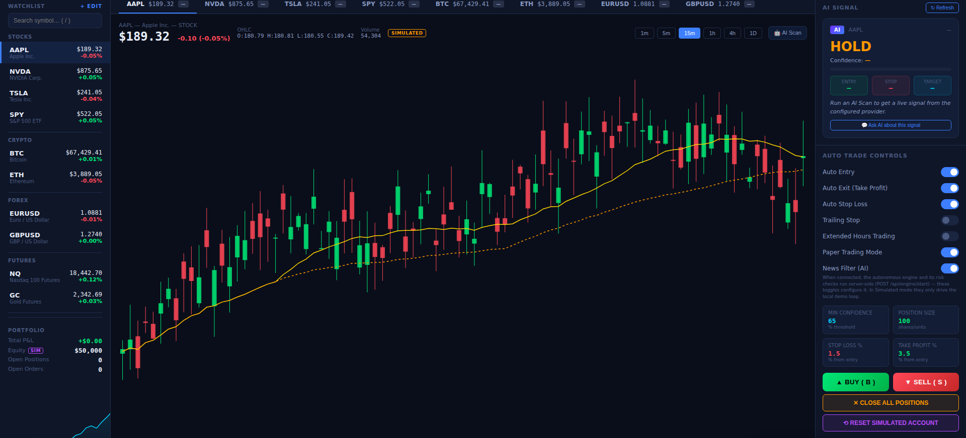
THE PLATFORM
A Trading Terminal Built to Ship
M
Multi-Tenant From the Ground Up
A Postgres-backed, multi-user architecture replaces the single-user demo — every account, position, and setting is isolated per user.
8
8 Core Indicators + One AI Score
RSI, MACD, Bollinger Bands, EMA 20/50, Volume, Stochastic, ATR and VWAP feed a composite AI Score in real time.
A
Autonomous Engine + Real Broker Bridge
Server-side auto-trading, position sizing, and a genuine Interactive Brokers connection via ib_insync — not a mock.
8
3
1
24/7
Core Indicators
AI Providers
Live Broker Bridge
Autonomous Engine
S
Hardened for Commercial Use
JWT + refresh tokens, email verification, TOTP 2FA, encrypted broker credentials, and a full audit trail.
Every account, every position, every setting — isolated per tenant.
ALPHATRADER PRO · COMMERCIAL EDITION
02 / 15

Slide 3
MARKET INTELLIGENCE
Eight Indicators, Read at a Glance
The indicator strip runs beneath every chart — recalculated on every tick, for every symbol on the watchlist, with the current regime spelled out in plain language underneath each reading.
R
RSI (14)
M
MACD (12,26,9)
B
Bollinger Bands
Overbought / oversold momentum read
Trend momentum and bullish / bearish crossovers
Mean-reversion bands with band-position callouts
E
EMA 20/50
V
Volume + Stochastic
A
ATR (14) + VWAP
Fast/slow trend alignment, at a glance
Participation and short-term exhaustion
Volatility sizing and intraday fair value
Plus a composite AI Score that folds all eight into one number.
ALPHATRADER PRO · COMMERCIAL EDITION
03 / 15

Slide 4
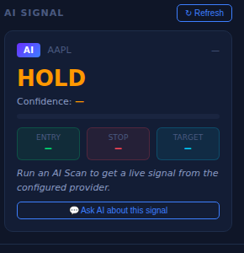
AI SIGNAL ENGINE
One AI Score, From a Provider You Choose
P
Pluggable AI Providers
Anthropic Claude, GPT, or DeepSeek — configured per deployment, with the API key stored server-side and never echoed back to the browser.
S
On-Demand AI Scan
A live AI Scan produces a directional call (Buy / Sell / Hold), a confidence score, and entry / stop / target levels.
G
Confidence-Gated, Not Just Suggested
The same AI Score that's shown to the trader is the one the autonomous engine checks against its minimum-confidence threshold.
?
“Ask AI About This Signal”
Configurable scan interval — the engine polls only as often as you tell it to.
Every signal links directly into the AI Chat Assistant for a plain-language explanation of the reasoning behind it.
ALPHATRADER PRO · COMMERCIAL EDITION
04 / 15

Slide 5
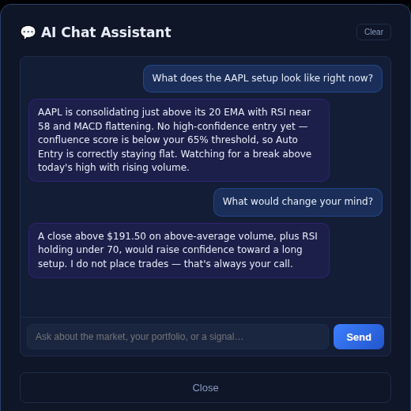
AI COPILOT
A Chat Assistant That Sees Your Live Data
C
Grounded in the Current Chart
Ask about a symbol and the assistant answers using the actual indicator readings on screen — not a generic market take.
T
States What Would Change Its Mind
Responses spell out the specific condition that would flip a Hold into a live setup — a level, a volume threshold, an indicator cross.
i
Explains — Never Executes
The assistant is explicit that it does not place trades; every order still requires the trader's own action on the ticket.
ALPHATRADER PRO · COMMERCIAL EDITION
05 / 15

Slide 6
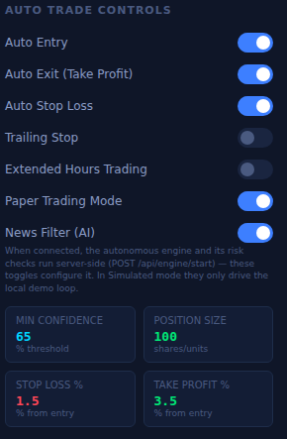
AUTONOMOUS ENGINE
Seven Switches. One Server-Side Engine.
1
Auto Entry, Auto Exit & Auto Stop Loss
The engine can open, take profit on, and protect positions on its own — each behavior toggled independently.
2
Trailing Stop, Extended Hours & News Filter (AI)
Layer in a trailing stop, allow pre/post-market activity, or let the AI provider veto entries around news risk.
3
Tunable Risk Parameters
Min Confidence, Position Size, Stop Loss % and Take Profit % are all set from the same panel that runs the engine.
4
Runs Server-Side, Not in the Browser Tab
Starting the engine calls the backend directly — it keeps working even if the trader closes the dashboard.
ALPHATRADER PRO · COMMERCIAL EDITION
06 / 15

Slide 7
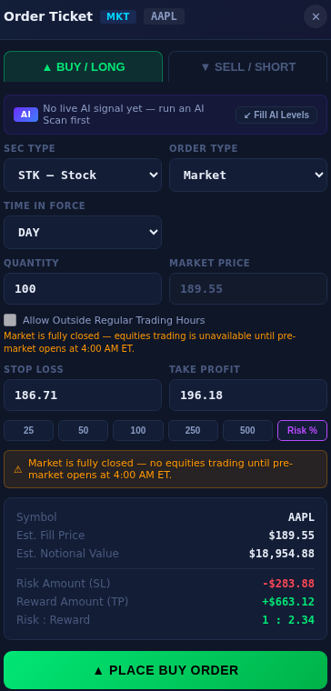
ORDER EXECUTION
An Order Ticket Built Like a Broker's
T
Every Order Type a Desk Expects
Stock or option security type, Market or Limit orders, and a full Time-in-Force selector, with outside-regular-hours trading as an explicit opt-in.
R
Auto-Calculated Risk on Every Ticket
Stop Loss and Take Profit levels compute Est. Fill Price, Notional Value, Risk Amount, Reward Amount, and Risk : Reward before the order is placed.
%
One-Click Position Sizing
Quick-size buttons — 25 / 50 / 100 / 250 / 500 shares, or a dedicated Risk % mode — replace manual share-count math.
AI
AI Levels, One Click Away
“Fill AI Levels” pulls the AI Signal's entry, stop, and target straight into the ticket.
ALPHATRADER PRO · COMMERCIAL EDITION
07 / 15

Slide 8
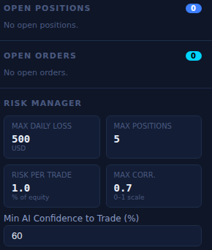
RISK MANAGEMENT
Guardrails the Client Can't Talk Its Way Around
D
Max Daily Loss
A hard USD ceiling on same-session losses, tracked live as “Daily P&L Used” against the configured limit.
P
Max Positions & Risk Per Trade
Caps how many positions can be open at once, and how much equity any single trade is allowed to risk.
C
Max Correlation
A 0–1 scale keeps the book from quietly concentrating into one correlated bet across several symbols.
Q
Minimum AI Confidence to Trade
No autonomous entry fires below this AI Score floor, whatever the individual indicators say.
!
Enforced Server-Side, Every Order
Checked on GET /api/risk/status by both manual orders and the autonomous engine — no client-only version to bypass.
The old client-only limits are gone — this now runs where a trader can't edit it.
ALPHATRADER PRO · COMMERCIAL EDITION
08 / 15

Slide 9
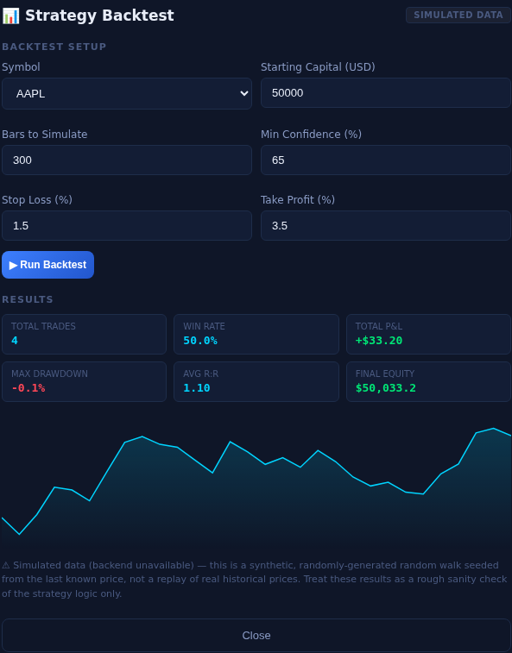
BACKTESTING
Sanity-Check the Logic Before You Trust It
1
Configurable in Seconds
Symbol, starting capital, bars to simulate, minimum confidence, stop loss % and take profit % — set and re-run instantly.
2
Full Performance Readout
Total trades, win rate, total P&L, max drawdown, average risk : reward, and final equity, plus an equity curve.
3
Runs the Same Rules the Engine Uses
Backtests apply the identical confidence and stop/target logic that drives live Auto Entry — no separate, friendlier ruleset.
4
Honest About Its Own Data
Every result is labeled: a synthetic random walk for sanity-checking logic, never presented as a replay of real history.
ALPHATRADER PRO · COMMERCIAL EDITION
09 / 15

Slide 10
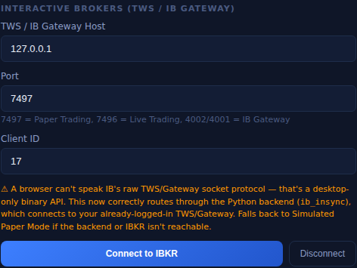
LIVE EXECUTION
When You're Ready, It Talks to a Real Broker
1
Real Interactive Brokers Connection
A Python backend bridges to TWS or IB Gateway via ib_insync — a browser can't speak IB's raw socket protocol, so this now routes correctly through the server.
2
Port-Based Paper vs. Live Detection
7497 for paper trading, 7496 for live, 4002/4001 for IB Gateway — the connected port alone decides the mode, confirmed on screen.
3
Per-User Client ID Isolation
Each tenant's IBKR session gets its own client ID, so multiple users on one deployment never collide on the same broker connection.
Falls back to Simulated Paper Mode automatically if the backend or IBKR isn't reachable.
4
Live Orders Require an Explicit Gate
A confirmLive flag is enforced server-side before real money moves — and the autonomous engine is never allowed to set it itself.
Trading involves substantial risk of loss and is not suitable for every investor.
ALPHATRADER PRO · COMMERCIAL EDITION
10 / 15

Slide 11
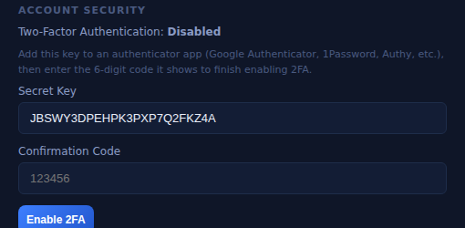
SECURITY & MULTI-TENANCY
Hardened for Real Users, Not Just a Demo
J
JWT + Refresh, Handled Silently
Access tokens live in memory only; a refresh token in an httpOnly cookie renews the session silently, with automatic retry on a 401.
E
Email Verification & TOTP 2FA
New accounts confirm by email; two-factor authentication adds a scannable secret and a 6-digit confirmation code on top of the password.
Two-Factor Authentication, configured directly in System Configuration.
K
Encrypted Secrets at Rest
Broker credentials and AI provider API keys are Fernet-encrypted server-side and never echoed back to the browser.
Postgres
TOTP
Fernet
Multi-Tenant DB
Two-Factor Auth
Secrets Encryption
L
Rate Limiting, Lockout & Audit Trail
Failed-login lockout, request rate limiting, and a full audit log of account and trading actions for compliance review.
ALPHATRADER PRO · COMMERCIAL EDITION
11 / 15

Slide 12
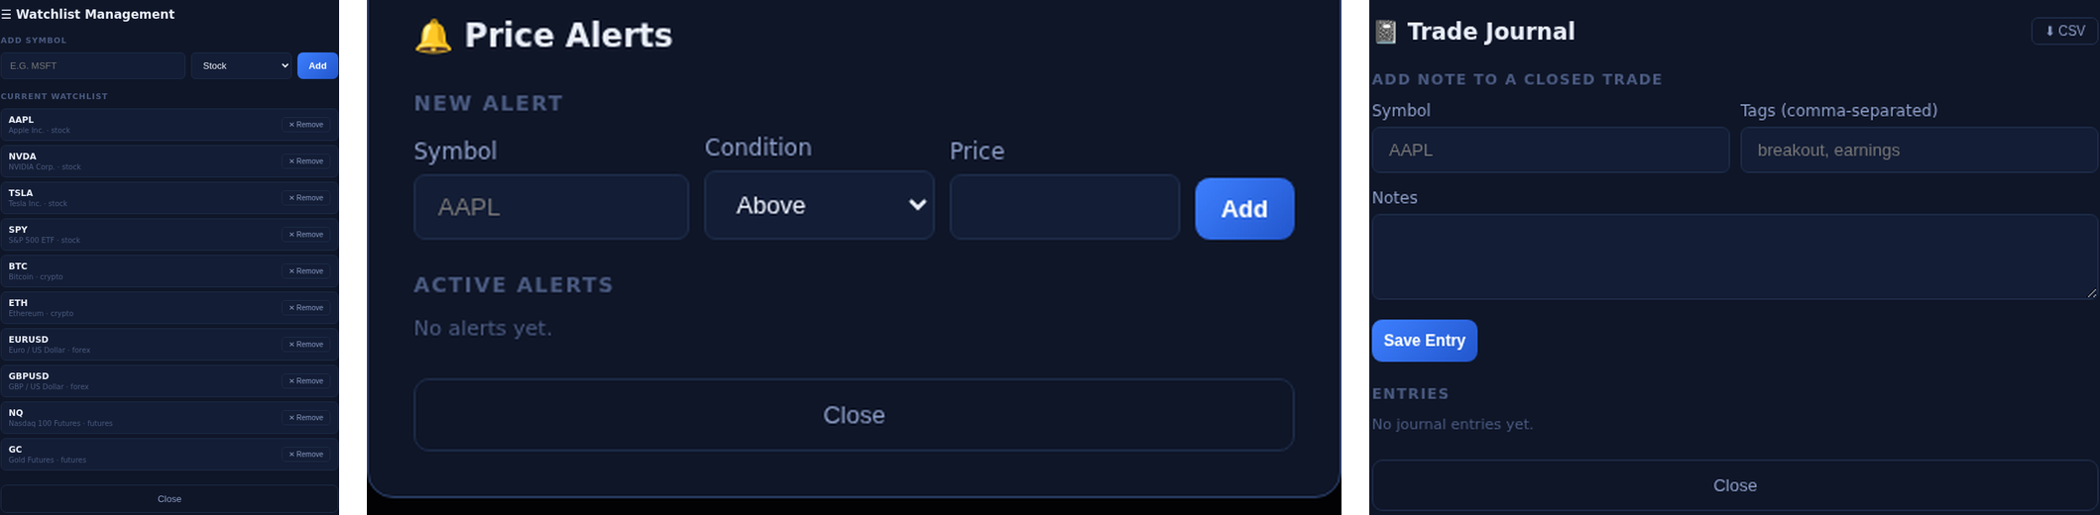
MONITORING
Watch, Get Alerted, and Keep the Record
W
Multi-Asset Watchlist
A
Price Alerts
J
Trade Journal
Stocks, crypto, forex, and futures side by side — add any symbol in one click.
Set an above / below trigger per symbol and get notified the moment it fires.
Tag and annotate closed trades, then export the full history as CSV whenever you want it.
ALPHATRADER PRO · COMMERCIAL EDITION
12 / 15

Slide 13
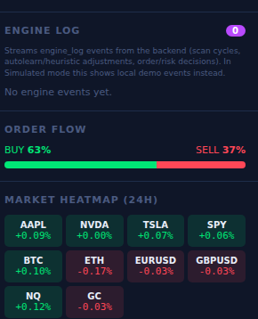
RELIABILITY & OPERATIONS
Live Data Streaming That Degrades Gracefully
W
WebSocket Live Streaming
Engine events, order flow, and price updates stream over a persistent connection instead of being polled.
H
24-Hour Market Heatmap
Every watchlist symbol — equities, crypto, forex, futures — colored by daily move, at a glance.
O
Buy / Sell Order Flow Readout
A live split of aggregate order flow direction across the account's recent activity.
S
Simulated Mode: Fails Open, Never Fails Silent
If the backend, IBKR, or AI provider is unreachable, the UI clearly banners “Simulated Mode” and keeps working on local demo data — it never just breaks.
ALPHATRADER PRO · COMMERCIAL EDITION
13 / 15

Slide 14
WORKFLOW & UX
Details That Save a Trader's Attention
?
Full Keyboard Shortcuts
T
Theme Toggle & Multi-Account
B / S for instant buy/sell tickets, / to jump to symbol search, Esc to close any modal.
Switch light/dark, or move between multiple connected accounts without reloading.
3
Three-Way Connection Readout
!
Always Know the Mode
Backend, IBKR, and AI provider status shown as separate live badges — never one ambiguous “connected” light.
A persistent Simulated Mode banner makes it unmistakable when trading against demo data instead of a live connection.
ALPHATRADER PRO · COMMERCIAL EDITION
14 / 15

Slide 15
ALPHATRADER PRO · COMMERCIAL EDITION
Trade Smarter. Trade Safer.
The full stack for the professional trader — real-time AI signals, an autonomous execution engine, server-side risk guardrails, a live broker bridge, and enterprise-grade security, in one terminal.
For more information and to purchase, visit
www.polyapps-ai.com
Trading involves risk, including loss of principal. Paper trading is recommended before connecting a live account.
ALPHATRADER PRO · COMMERCIAL EDITION
15 / 15

