Slide 1
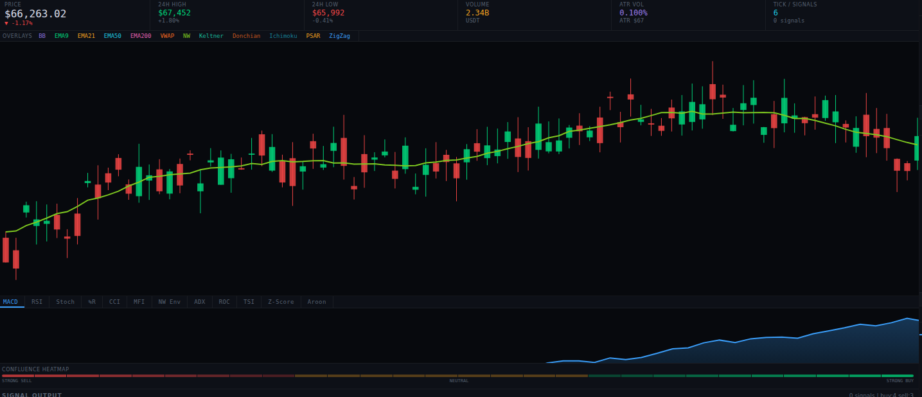
QUANTITATIVE TRADING PLATFORM
ANALYTECHS
ALGOTRADER
v8.0
Institutional-grade indicators, automated execution, and a live brokerage connection — built for traders who think in edge, not hype.
32 Indicators
Auto Execute
Live IBKR Bridge
AI Copilot
For the professional trader.
ANALYTECHS ALGOTRADER · v8.0
01 / 15

Slide 2
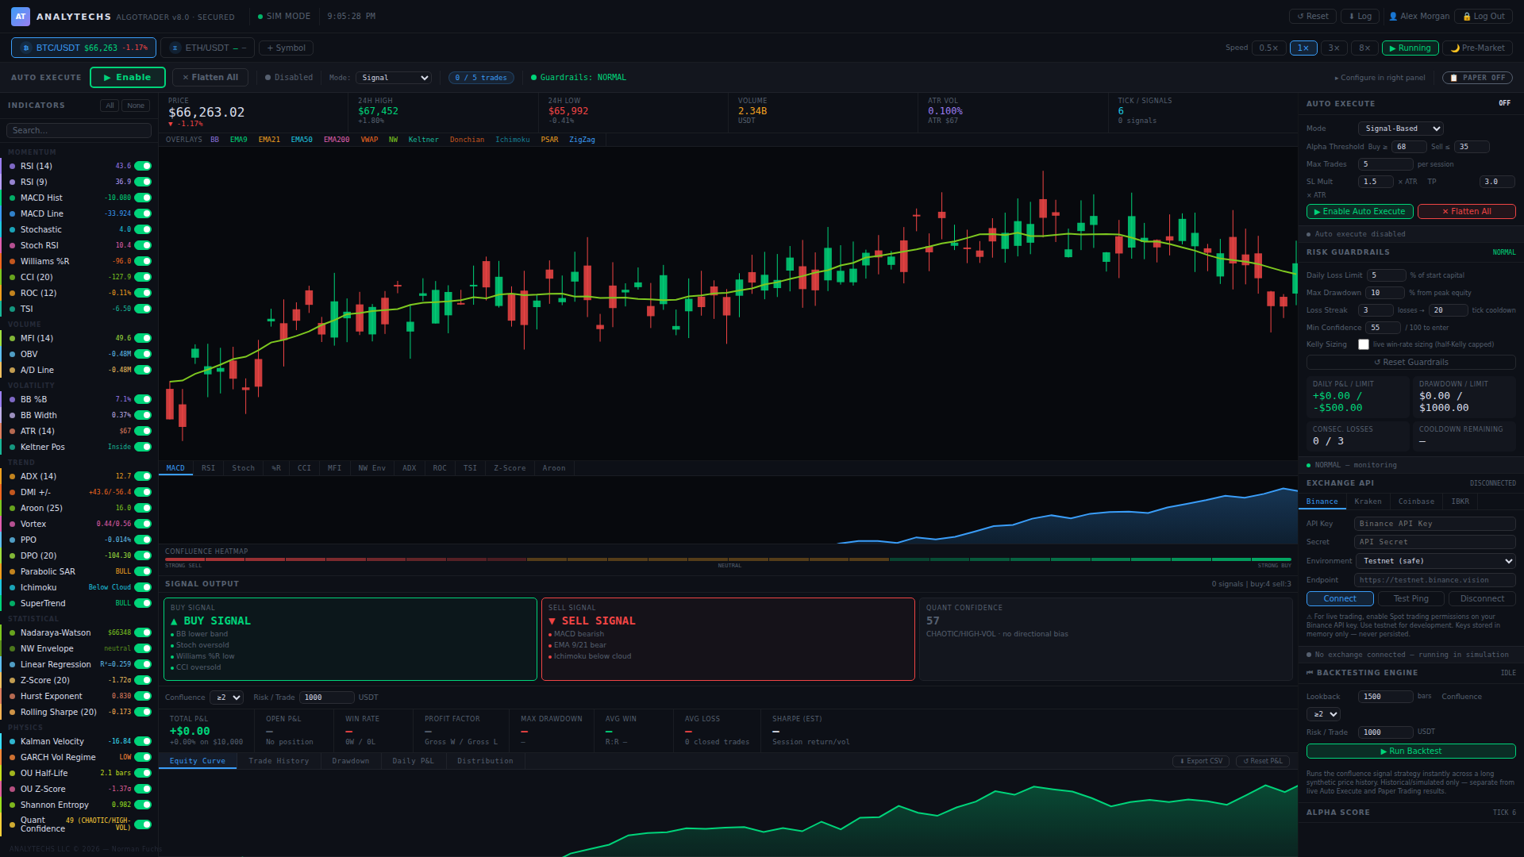
THE PLATFORM
One Terminal. Every Edge.
M
Live Multi-Market Dashboard
Simulated crypto feeds (Binance / Kraken / Coinbase-style) plus a real Interactive Brokers connection — one screen, one workflow.
32
32 Quant Indicators, 6 Disciplines
Momentum, volume, volatility, trend, statistical and physics-based models all feed one confluence engine.
A
Automated + AI-Assisted Execution
Auto Execute, Paper Trading, instant backtesting, and an AI copilot that reviews every trade before it becomes real.
32
6
4
1
S
Secured, Cloud-Synced Backend
bcrypt + JWT accounts and a cloud-synced trade journal replace the old client-only demo.
Indicators
Disciplines
Market Connections
Live Broker Bridge
ANALYTECHS ALGOTRADER · v8.0
02 / 15

Slide 3
SIGNAL LIBRARY
32 Indicators Across Six Disciplines
M
Momentum
V
Volume
V
Volatility
RSI (14/9) · MACD · Stochastic · Stoch RSI · Williams %R · CCI · ROC · TSI
MFI (14) · OBV · A/D Line
Bollinger %B / Width · ATR (14) · Keltner Position
Ten oscillators gauge the speed and exhaustion of every move.
Confirms whether price action has real participation behind it.
Sizes risk and flags expansion / contraction regimes.
T
Trend
S
Statistical
P
Physics
ADX / DMI · Aroon · Vortex · PPO · Ichimoku · SuperTrend · Parabolic SAR
Nadaraya-Watson · Linear Regression · Z-Score · Hurst Exponent · Rolling Sharpe
Kalman Velocity · GARCH(1,1) Vol Regime · Ornstein-Uhlenbeck · Shannon Entropy
Seven trend systems keep you aligned with the tape.
Kernel regression and regime statistics most retail platforms skip.
Signal-processing and econophysics models feed one Quant Confidence score.
ANALYTECHS ALGOTRADER · v8.0
03 / 15

Slide 4
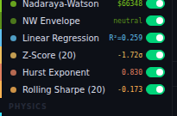
STATISTICAL INDICATORS
Statistics That Go Beyond Chart Patterns
N
Nadaraya-Watson Kernel Regression
An adaptive, non-parametric smoothing line overlaid directly on price — reacts to regime changes faster than a fixed moving average.
R
Linear Regression R²
Scores trend quality in real time — a low R² warns you a “trend” is really just noise.
Z
Z-Score (20)
Flags statistically extreme price deviations for mean-reversion entries and exits.
H
Hurst Exponent
Classifies the regime as trending, mean-reverting, or random walk — the R/S estimator is QA-verified, not a placeholder.
Live in the indicator sidebar — not a hidden backend calculation.
S
Rolling Sharpe (20)
A live, rolling risk-adjusted performance read, recalculated every tick.
ANALYTECHS ALGOTRADER · v8.0
04 / 15

Slide 5
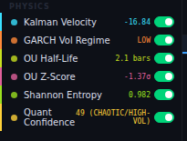
PHYSICS & ECONOPHYSICS
Signal Processing Meets Market Structure
K
Kalman Velocity
A Kalman filter estimates the market's true underlying velocity, filtering tick noise out of every directional call.
G
GARCH(1,1) Volatility Regime
Classifies volatility as low, normal, elevated, or chaotic — the way a derivatives desk would.
O
Ornstein-Uhlenbeck Half-Life & Z-Score
Measures how fast price reverts to its mean, and how far it currently sits from it.
QUANT CONFIDENCE
Σ
Shannon Entropy
One composite score, 0–100
Quantifies how random vs. structured recent price action really is.
Combines every statistical and physics model above — and feeds Auto Execute's minimum-confidence entry gate.
ANALYTECHS ALGOTRADER · v8.0
05 / 15

Slide 6
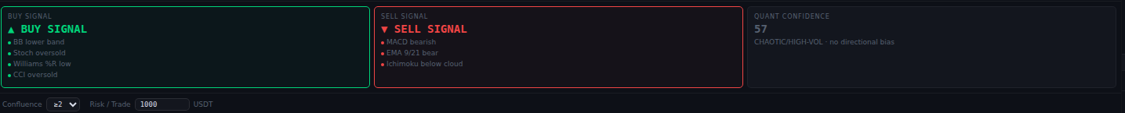
SIGNAL ENGINE
One Confluence Engine, Every Indicator Voting
Every indicator casts a vote. The confluence heatmap and an adjustable ≥ 2 / ≥ 3 / ≥ 4 threshold turn 32 separate readings into one Buy, Sell, or Neutral call — with the reasoning shown, never hidden.
≥
Adjustable confluence threshold, ≥ 2 to ≥ 5 indicators
i
Live reasoning per signal — never a black box
α
Alpha Score gauge (0–100) for at-a-glance conviction
ANALYTECHS ALGOTRADER · v8.0
06 / 15

Slide 7
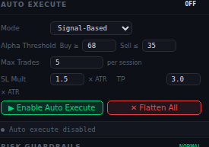
AUTO EXECUTE
Automated Execution — Long and Short
M
Signal-Based or Threshold Modes
Choose confluence-driven entries, or set explicit buy ≥ / sell ≤ alpha thresholds yourself.
A
ATR-Based Stop-Loss & Take-Profit
SL / TP multiples scale automatically with current volatility (ATR), not a fixed dollar amount.
#
Session Trade Caps
A max-trades-per-session limit keeps automation from over-trading a choppy tape.
Configured live in the Auto Execute panel.
↔
Long and Short, One Engine
The same confluence logic drives both directions symmetrically — no separate short-only mode to configure.
ANALYTECHS ALGOTRADER · v8.0
07 / 15

Slide 8
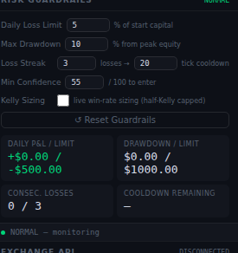
RISK MANAGEMENT
Guardrails That Trade Like a Risk Desk
D
Daily Loss Limit
Trading pauses automatically once a session's loss hits your configured % of starting capital.
M
Max Drawdown Kill Switch
A peak-to-trough drawdown limit trips the system before losses can compound.
C
Consecutive-Loss Cooldown
N losing trades in a row triggers a timed entry cooldown, not an indefinite shutdown.
Minimum-Confidence Entry Gate
All five guardrails run live, every tick — not a policy document.
Q
No new position opens below your Quant Confidence floor.
V
Volatility-Scaled Position Sizing
Size shrinks automatically as ATR volatility rises.
ANALYTECHS ALGOTRADER · v8.0
08 / 15

Slide 9
CAPITAL ALLOCATION
Position Sizing, Backed by the Math
K
Half-Kelly Sizing
MC
Monte Carlo Win Probability
f * = p − (1 − p) / (W / L)
500 simulations × 15 steps
Position size scales with your live win-rate and win/loss ratio via the Kelly criterion — hard-capped at 25% of equity so a hot streak never becomes a blow-up.
Forward-simulates the current setup before sizing it — instead of just assuming yesterday's edge holds today.
Both feed the same Risk Guardrails engine — sizing and survival, not just signals.
ANALYTECHS ALGOTRADER · v8.0
09 / 15

Slide 10
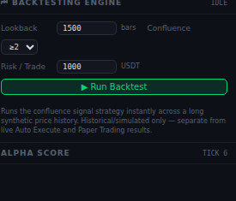
BACKTESTING
Test the Strategy Before You Trust It
1
Instant Historical Simulation
Runs the exact confluence strategy across 1,500+ synthetic bars in seconds, not minutes.
2
Configurable Lookback & Confluence
Test different history windows and signal thresholds side-by-side before going live.
3
Full Performance Readout
Equity curve, win rate, profit factor, average win/loss, max drawdown, and an estimated Sharpe ratio.
4
Cleanly Separated From Live Results
Backtests never mix with live Auto Execute or Paper Trading history.
ANALYTECHS ALGOTRADER · v8.0
10 / 15

Slide 11
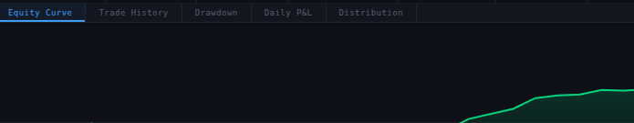
PAPER TRADING
Paper Trade Every Order Type, Risk-Free
O
Market, Limit, Stop & Trailing-Stop Orders
The full order-type vocabulary, simulated realistically before a single dollar is at risk.
S
Session-Persisted Positions
Your paper book, watchlist, and settings survive a page reload — nothing resets by accident.
Equity Curve · Trade History · Drawdown · Daily P&L · Distribution
D
Equity Curve, Drawdown & Distribution Analytics
Four dedicated tabs — Equity Curve, Trade History, Drawdown, Distribution — break down every session.
E
One-Click CSV Export
Pull the full trade history out whenever you want it — no screen-scraping required.
ANALYTECHS ALGOTRADER · v8.0
11 / 15

Slide 12
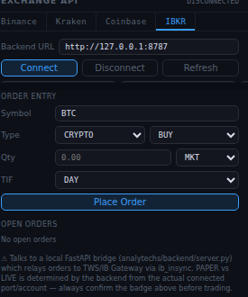
LIVE EXECUTION
When You're Ready, It Talks to a Real Broker
1
Real Interactive Brokers Connection
A FastAPI bridge talks to your local TWS or IB Gateway via ib_async — not a simulation.
2
Automatic Paper vs. Live Detection
The connected port alone determines trading mode; the on-screen badge always confirms it.
3
Typed Confirmation Before Real Money Moves
A live order requires the literal phrase “I UNDERSTAND THIS IS REAL MONEY” — enforced by the backend, not just the UI.
4
Live Positions, Orders & Account Summary
Net liquidation, buying power, and P&L pulled straight from your broker connection.
Trading involves substantial risk of loss and is not suitable for every investor.
ANALYTECHS ALGOTRADER · v8.0
12 / 15

Slide 13
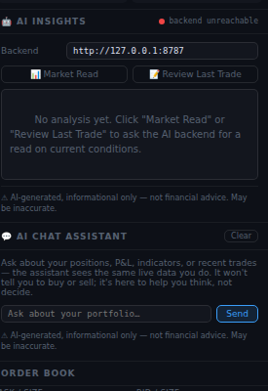
AI-ASSISTED TRADING
An AI Copilot That Explains, Never Commands
R
AI Insights — Market Read & Review Last Trade
On-demand reads of current conditions, or a review of your last closed trade.
C
AI Chat Assistant
Ask in plain English about positions, P&L, indicators, or recent trades — it sees your live data.
P
AI Pre-Trade Risk Review
A review modal appears before IBKR orders submit — a second opinion, never a blocker.
i
Informational Only, By Design
Explicitly instructed to never issue buy/sell commands or predict specific future prices.
ANALYTECHS ALGOTRADER · v8.0
13 / 15

Slide 14
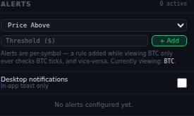
MONITORING & INFRASTRUCTURE
Stay Informed, Stay Secured
A
Price & Indicator Alerts
Desktop notifications when any of the 32 indicators — or price itself — crosses your threshold, per symbol.
W
Multi-Symbol Watchlist
Add any symbol with a seeded simulated feed alongside BTC/ETH in one click.
S
Bank-Style Account Security
bcrypt-hashed passwords and JWT session tokens — single-user-secured by default.
J
Cloud-Synced Trade Journal
Every closed Auto Execute and Paper Trading round-trip syncs to the backend, exportable as CSV anytime.
ANALYTECHS ALGOTRADER · v8.0
14 / 15

Slide 15
ANALYTECHS ALGOTRADER · v8.0
Trade With An Edge.
The whole stack for the professional trader — 32 quant indicators, automated execution, institutional risk guardrails, an AI copilot, and a real broker connection, all in one terminal.
For more information and to purchase, visit
www.polyapps-ai.com
Trading involves risk, including loss of principal. Paper trading is recommended before connecting a live account.
ANALYTECHS ALGOTRADER · v8.0
15 / 15

